Slide 1

Music recommendation using Clustering
ADVAIT KULKARNI SUHIT DATTA
VARAD TUPE

Slide 2
Agenda
General Idea & Data Acquisition
Exploratory Data Analysis
Clustering
Applications and Future Scope

Slide 3
General Idea
Extract the quantitative nuances of a song.
Can we group them together based on the data?
Clustering based on similarity of songs (Audio Features) and not just on Genres.
Build a Recommendation system that would pick songs from these clusters : Such songs would have similar harmonics/characteristics.

Slide 4
Data Acquisition
Data selected from Spotify Top charts
Genre:
Pop
EDM
Metal
Acoustic
Country
Rap

Slide 5
Data Acquisition
spotify-api for fetching data from Spotify Web-API
pygn for fetch data from Gracenote API
Get Playlist’s Tracks API for fetching track ids of songs
Get Audio Features for Several Tracks API for fetching audio features

Slide 6
Features
Feature | Source | Description
artist | Spotify | Artist Name
album | Spotify | Album Name
track_name | Spotify | Track Name
genre | Manually Tagged | Genre of playlist
acousticness | Spotify | A confidence measure from 0.0 to 1.0 of whether the track is acoustic. 1.0 represents high confidence the track is acoustic.
danceability | Spotify | Danceability describes how suitable a track is for dancing based on a combination of musical elements including tempo, rhythm stability, beat strength, and overall regularity. A value of 0.0 is least danceable and 1.0 is most danceable.
duration_ms | Spotify | The duration of the track in milliseconds.
energy | Spotify | Energy is a measure from 0.0 to 1.0 and represents a perceptual measure of intensity and activity. Typically, energetic tracks feel fast, loud, and noisy. For example, death metal has high energy, while a Bach prelude scores low on the scale. Perceptual features contributing to this attribute include dynamic range, perceived loudness, timbre, onset rate, and general entropy.
instrumentalness | Spotify | Predicts whether a track contains no vocals. "Ooh" and "aah" sounds are treated as instrumental in this context. Rap or spoken word tracks are clearly "vocal". The closer the instrumentalness value is to 1.0, the greater likelihood the track contains no vocal content. Values above 0.5 are intended to represent instrumental tracks, but confidence is higher as the value approaches 1.0.

Slide 7
Features
Feature | Source | Description
key | Spotify | The key the track is in. Integers map to pitches using standard Pitch Class notation. E.g. 0 = C, 1 = C♯/D♭, 2 = D, and so on.
loudness | Spotify | The overall loudness of a track in decibels (dB). Loudness values are averaged across the entire track and are useful for comparing relative loudness of tracks. Loudness is the quality of a sound that is the primary psychological correlate of physical strength (amplitude). Values typical range between -60 and 0 db.
mode | Spotify | Mode indicates the modality (major or minor) of a track, the type of scale from which its melodic content is derived. Major is represented by 1 and minor is 0.
speechiness | Spotify | Speechiness detects the presence of spoken words in a track. The more exclusively speech-like the recording (e.g. talk show, audio book, poetry), the closer to 1.0 the attribute value. Values above 0.66 describe tracks that are probably made entirely of spoken words. Values between 0.33 and 0.66 describe tracks that may contain both music and speech, either in sections or layered, including such cases as rap music. Values below 0.33 most likely represent music and other non-speech-like tracks.
tempo | Spotify | The overall estimated tempo of a track in beats per minute (BPM). In musical terminology, tempo is the speed or pace of a given piece and derives directly from the average beat duration.
time_signature | Spotify | An estimated overall time signature of a track. The time signature (meter) is a notational convention to specify how many beats are in each bar (or measure).
valence | Spotify | A measure from 0.0 to 1.0 describing the musical positiveness conveyed by a track. Tracks with high valence sound more positive (e.g. happy, cheerful, euphoric), while tracks with low valence sound more negative (e.g. sad, depressed, angry).
mood | Gracenote | Mood of a song

Slide 8
Mood Taxonomy
https://neokt.github.io/projects/audio-music-mood-classification/

Slide 9
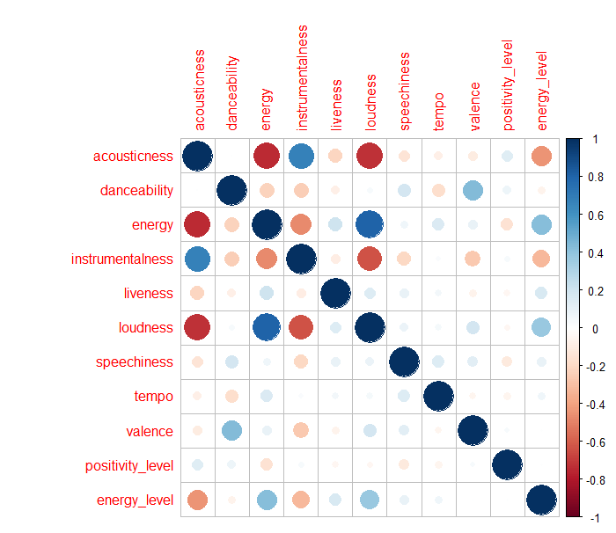
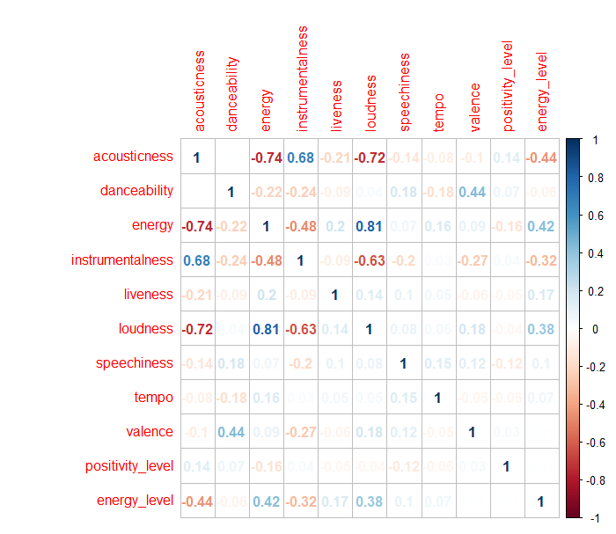
Correlation Plot between the variables :

Slide 10
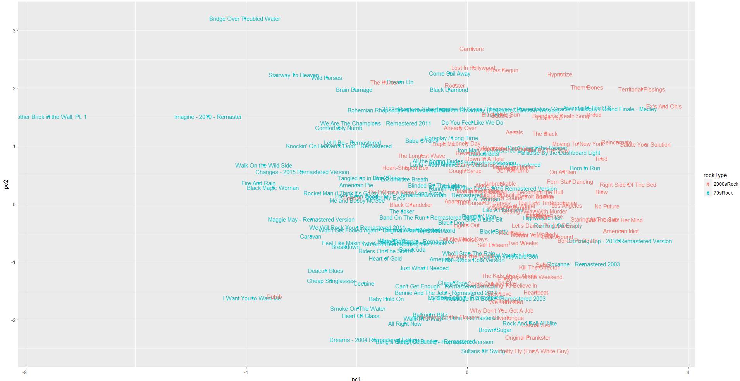
Appetizer for Rock Enthusiasts!

Slide 11
Appetizer for Rock Enthusiasts!

Slide 12
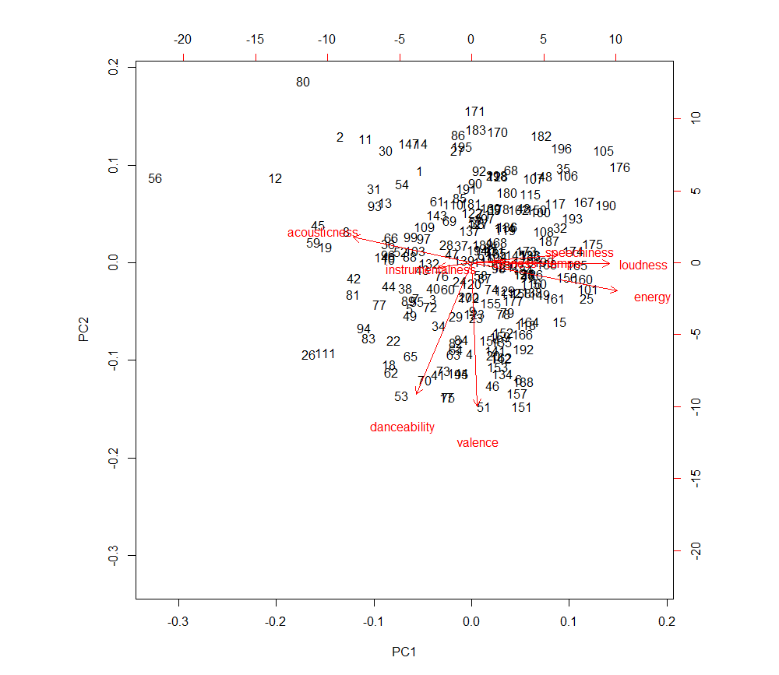
Appetizer for Rock Enthusiasts!
Name | Loudness | Energy | Acousticness | Valence
Knocking on Heaven’s Door (1973) | -13.061 | 0.396 | 0.251 | 0.229
Salute Your Solution (2008) | -2.855 | 0.946 | 0.00781 | 0.498
Original Prankster (2000) | -4.149 | 0.886 | 0.00061 | 0.942
Sultans of Swing (1978) | -7.325 | 0.868 | 0.0632 | 0.923

Slide 13
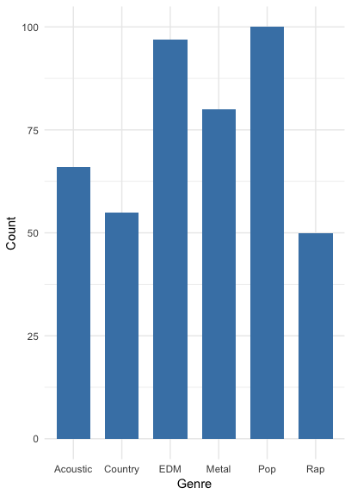
Data distribution by genres

Slide 14
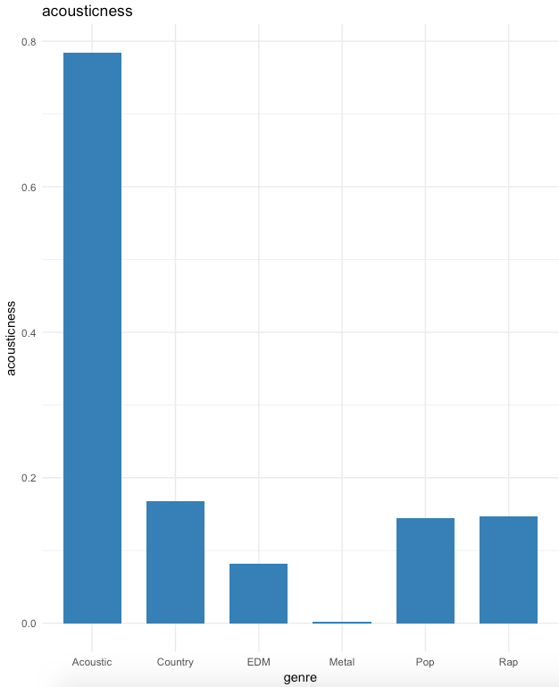
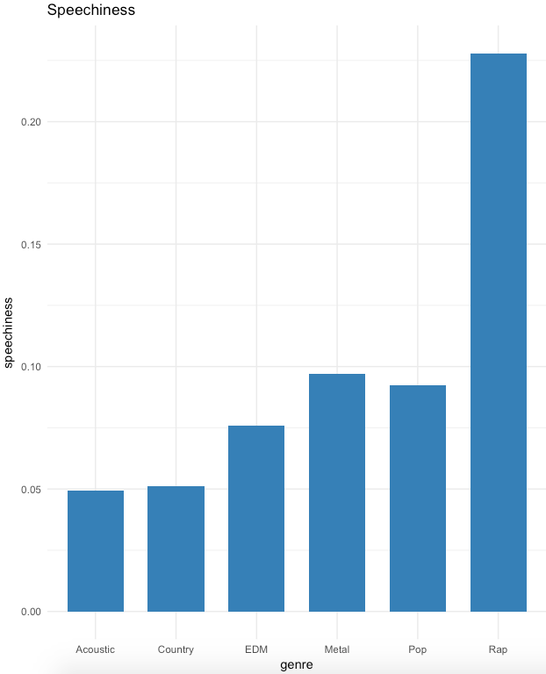
Feature Characteristics by Genre

Slide 15
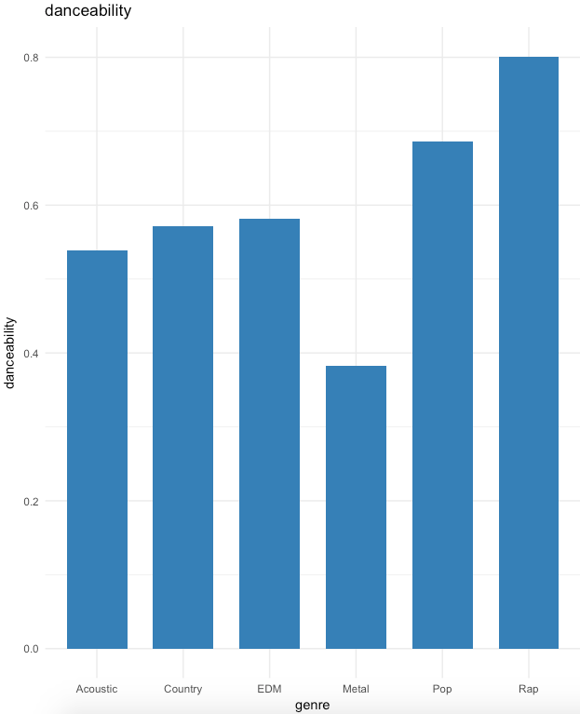
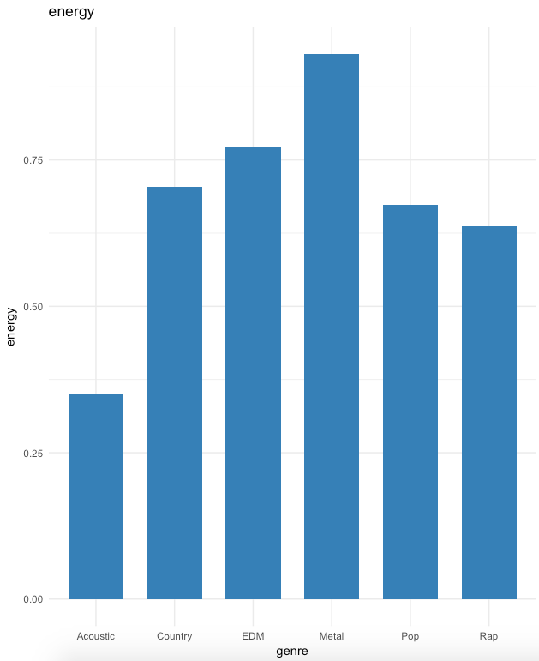
Feature Characteristics by Genre

Slide 16
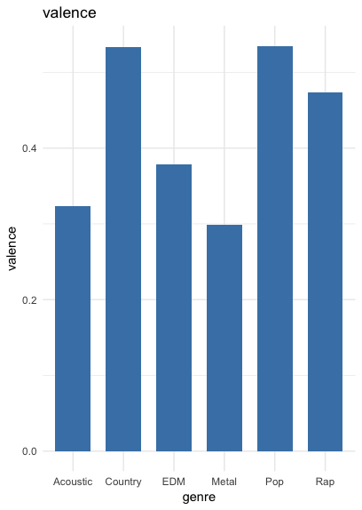
Feature Characteristics by Genre

Slide 17
Data Pre-Processing
Speechiness
Loudness
Tempo
Valence
Feature Selection
Acousticness
Danceability
Energy
Instrumentalness
Liveness

Slide 18
Data Pre-Processing
T-Distributed Stochastic Neighboring Entities (t-SNE)
Dimension reduction technique.
A probabilistic approach.
Uses T-Distribution.
Retains the structure in lower dimensions.

Slide 19
Clustering
Clustering algorithms used:
Hierarchical Clustering
K Means Clustering
K Medoids Clustering

Slide 20
Finding best number of cluster

Slide 21
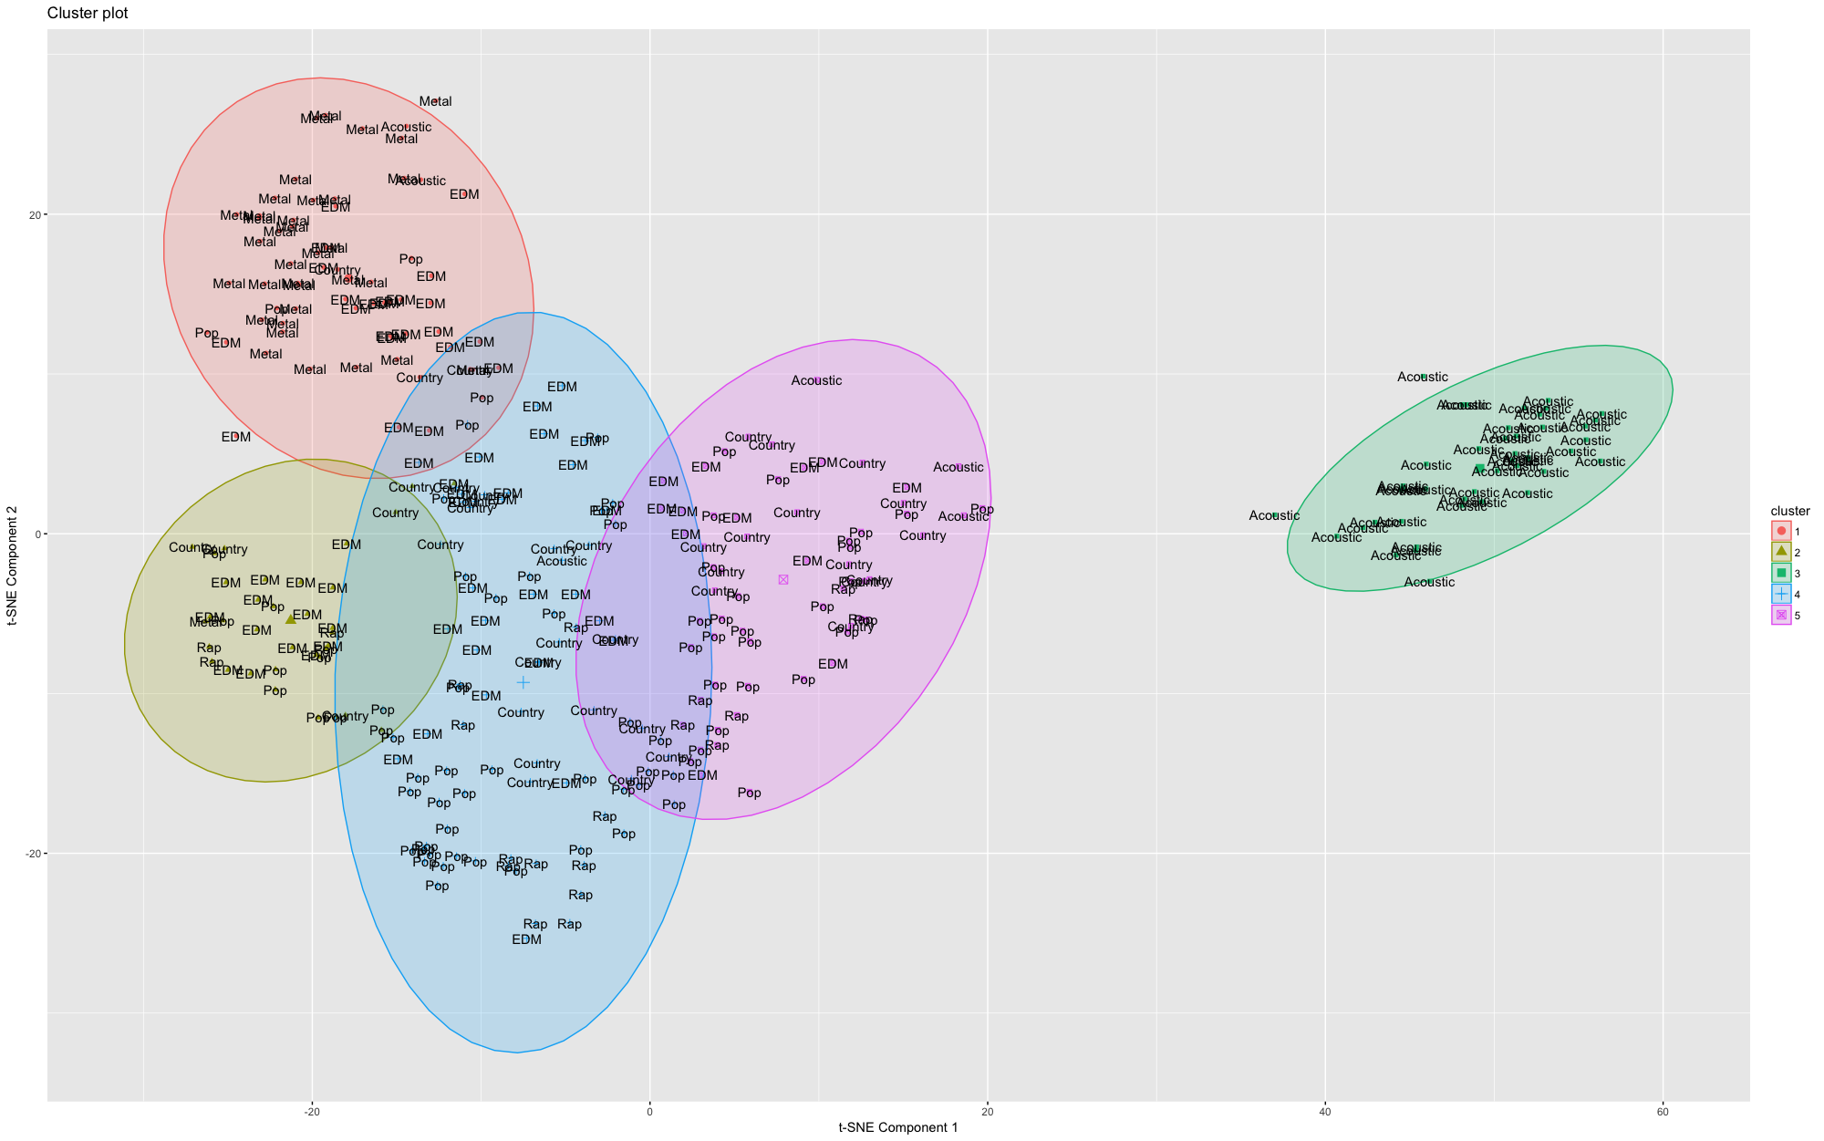
K-Means Clustering (By Genre)

Slide 22

K-Means Clustering (By Mood)

Slide 23
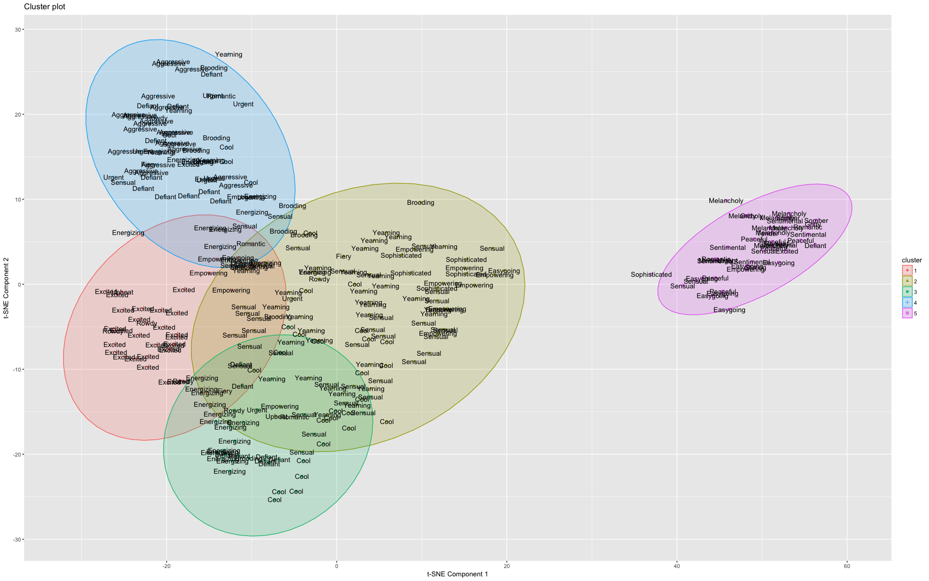
K-Medoids Clustering (By Mood)

Slide 24
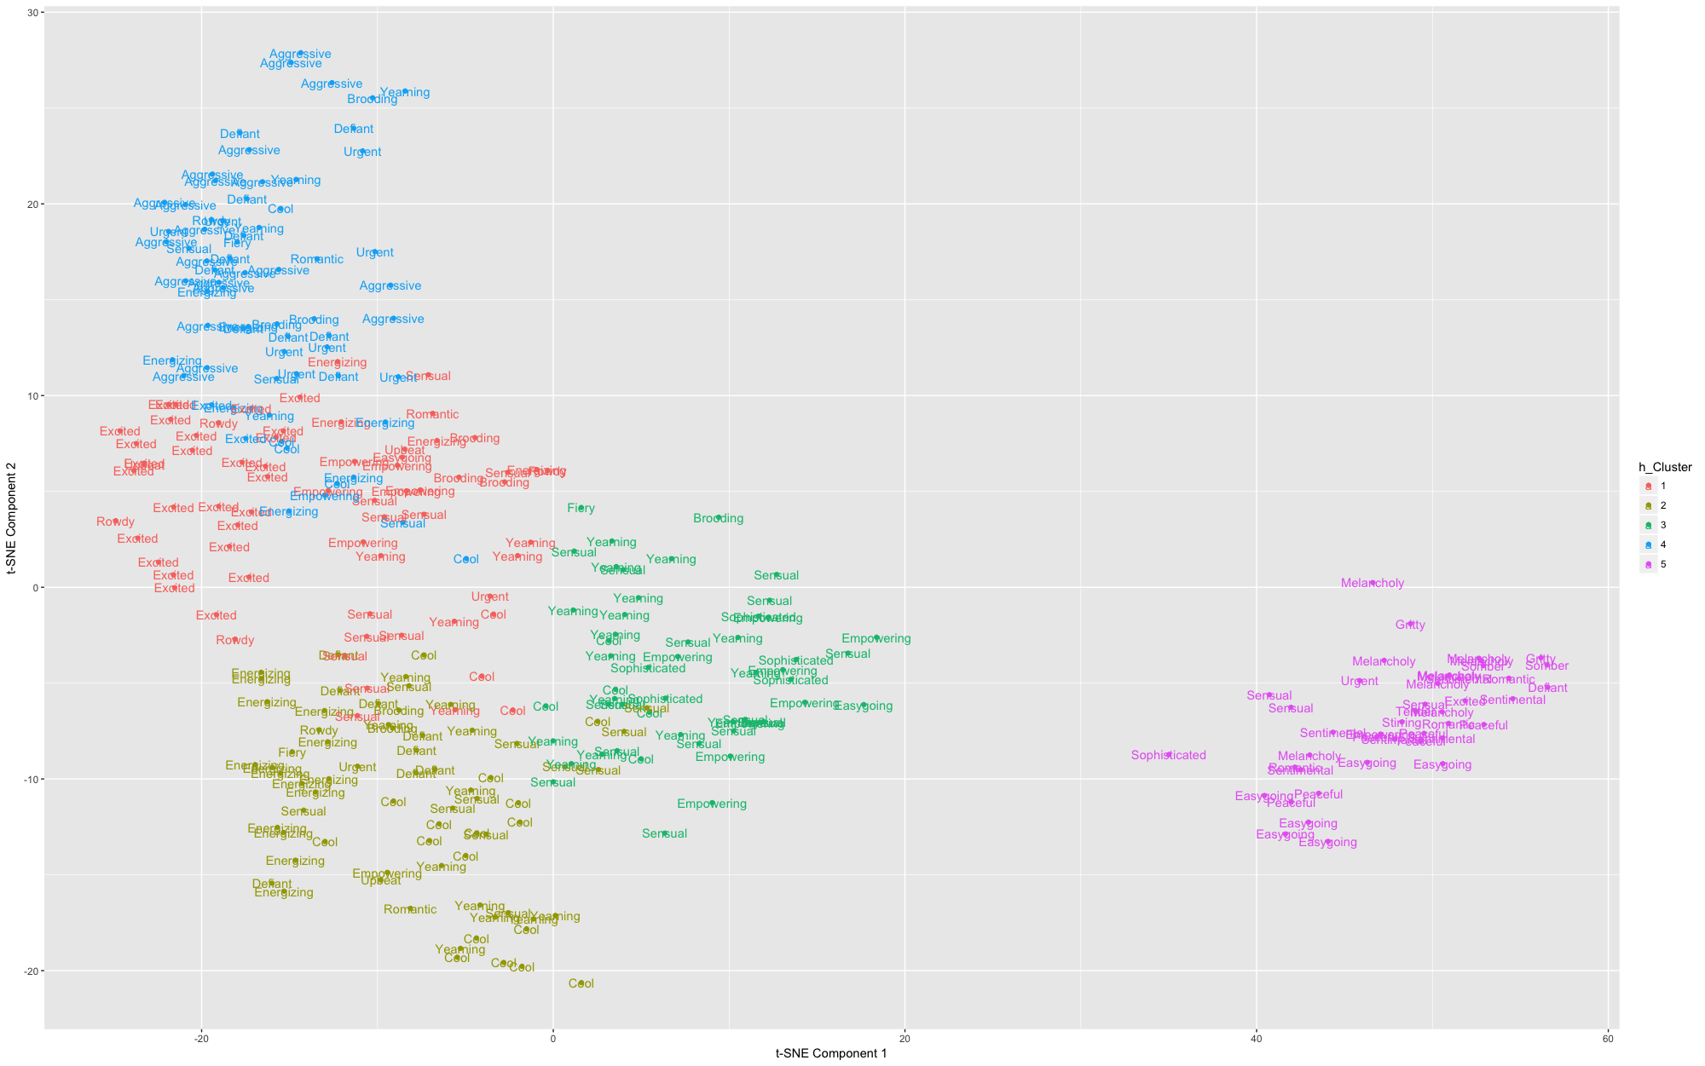
Hierarchical Clustering (By Mood)

Slide 25
Hierarchical Clustering (By Mood)

Slide 26
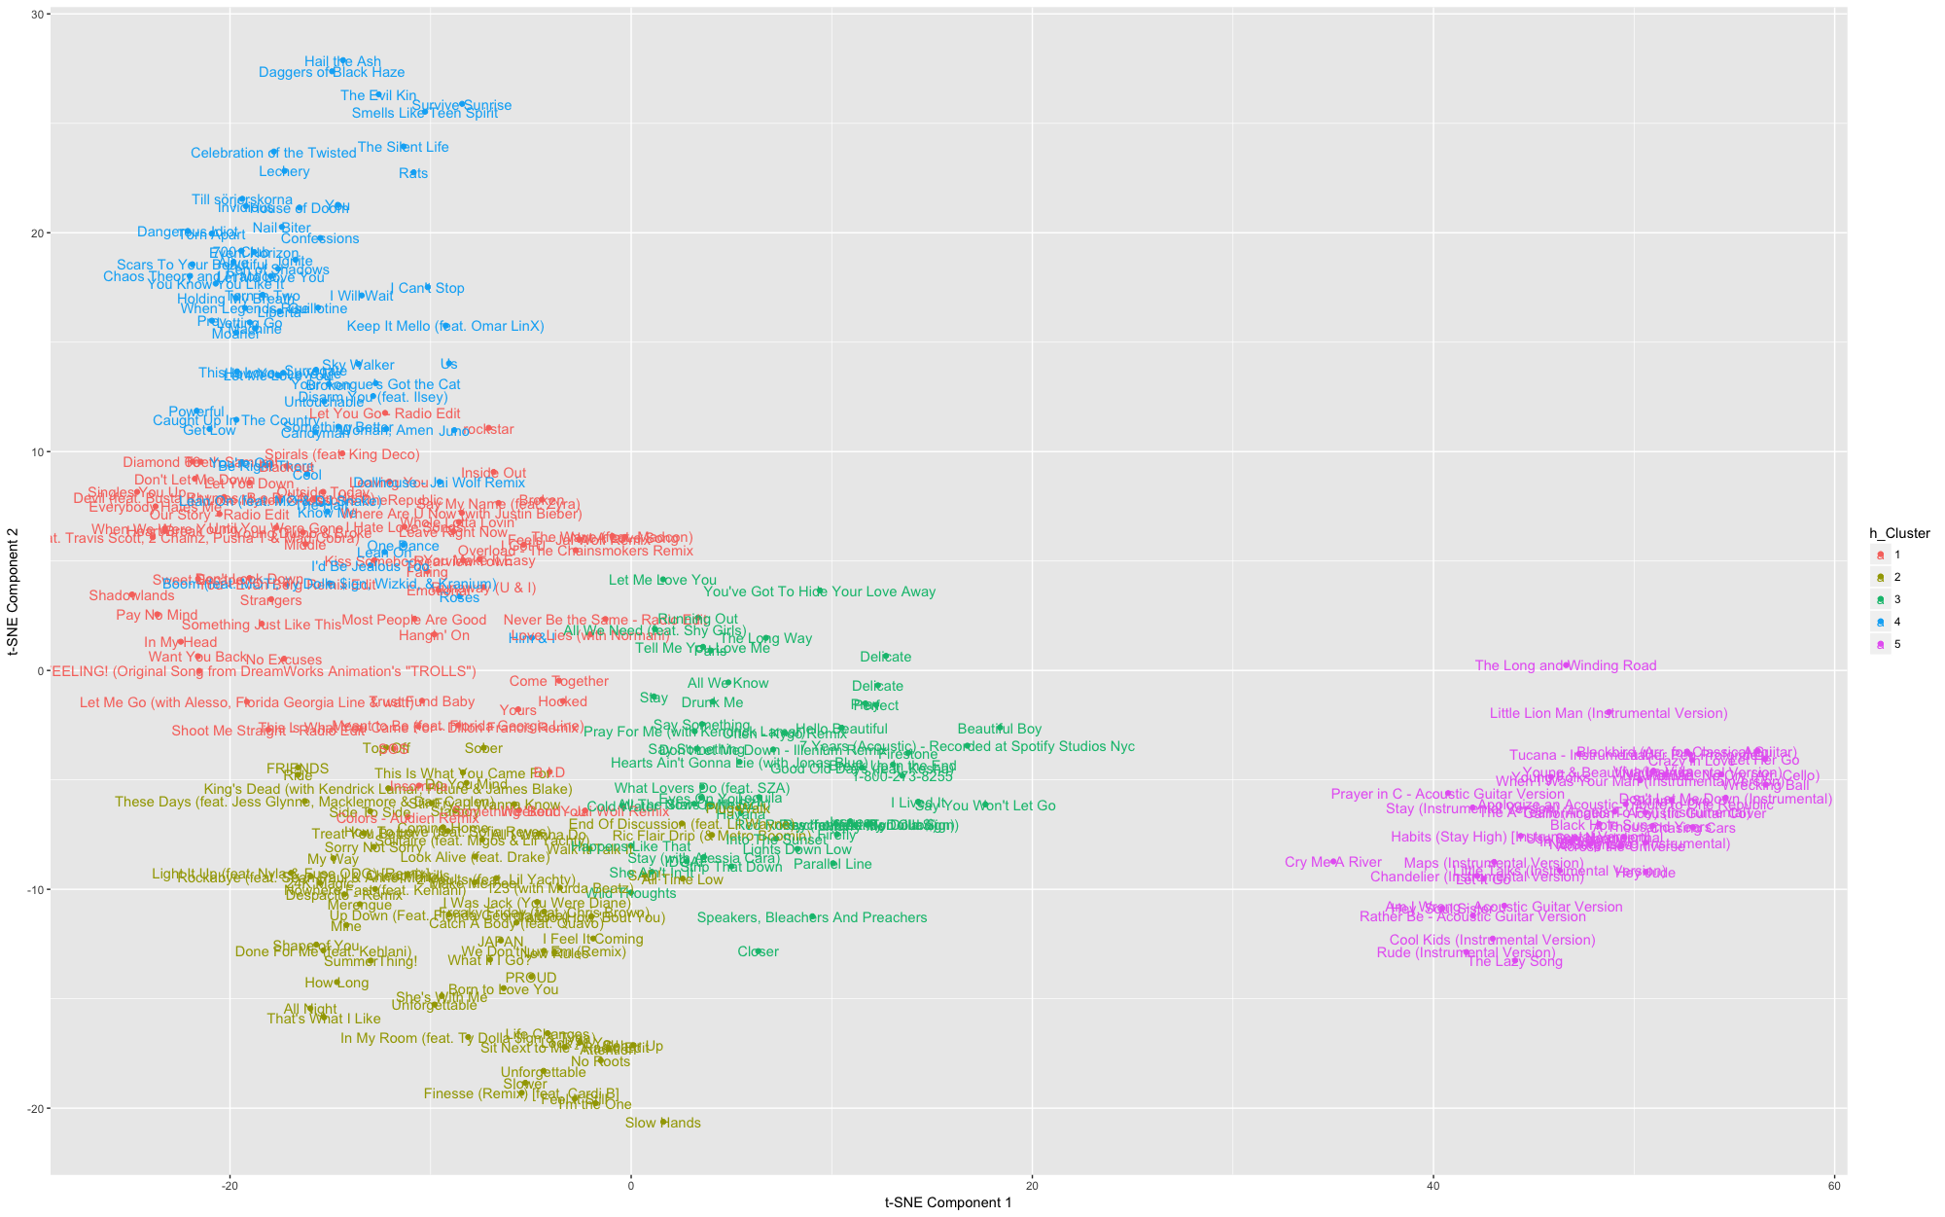
Hierarchical Clustering (By track)

Slide 27
Hierarchical Clustering (By track)
Smells Like Teen Spirit (Nirvana) | Survive Sunrise (ASG)
Something Just Like This (Coldplay) | Strangers (Seven Lions)
All We Know (The Chainsmokers) | Drunk Me (Mitchell Tenpenny)
That’s What I Like (Bruno Mars) | All Night (Big Boi)
Dark
Energetic
Calm
Positive

Slide 28
Applications and Future Scope
Grid Based Music Interface for playing songs which sound similar.
Integration with Spotify and other Music Applications.
Incorporating additional features to scale up the model for efficient clustering of songs.
Labeling the cluster based on characteristics.
Creating a Similarity Index between two songs : Quantitative representation of how close a song is to another song based on these features. Can modify the radius of Similarity.
Using Lyrics in addition to audio features for better recommendations! Natural Language Processing for lyrics text
AUDIO FEATURES + LYRICS CONTENT = BETTER RECOMMENDATION

Slide 29
